Slide 1
TICKETING MANAGEMENT
Andryan Duta Gama
Dimas Wisnu N
Devie Viera Septiana Sari
Faisal Akbar P
JDC Bootcamp
2017

Slide 2
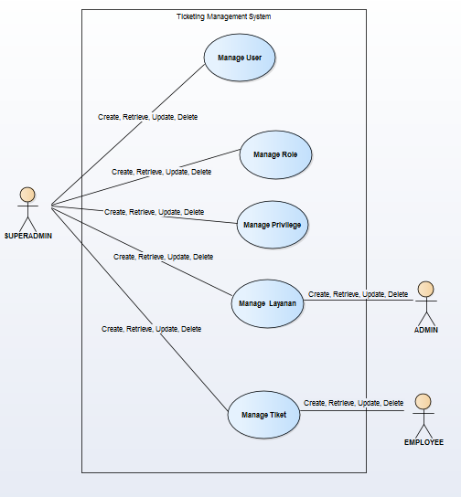
Use Case Diagram

Slide 3
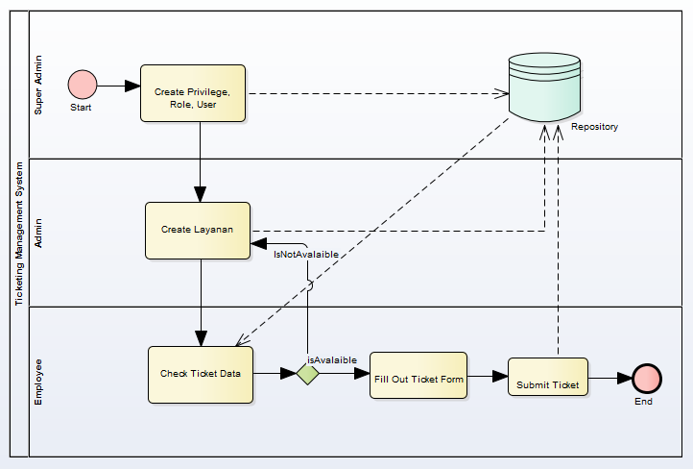
Business Process

Slide 4
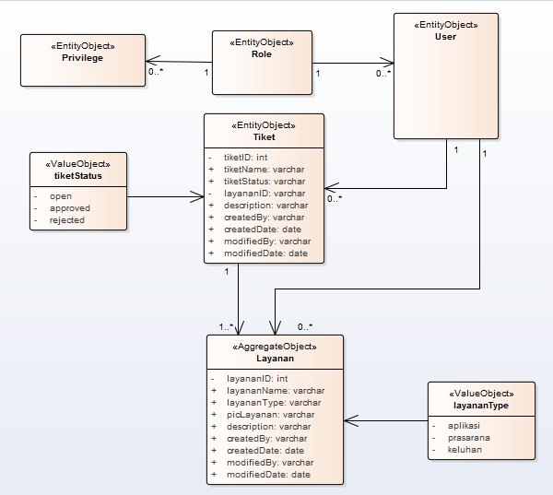
Class Diagram

Slide 5
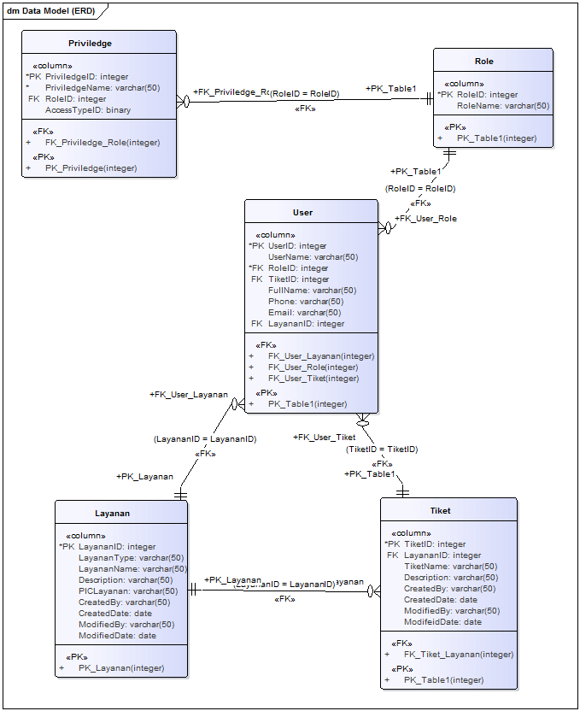
Data Model (ERD)

Slide 6
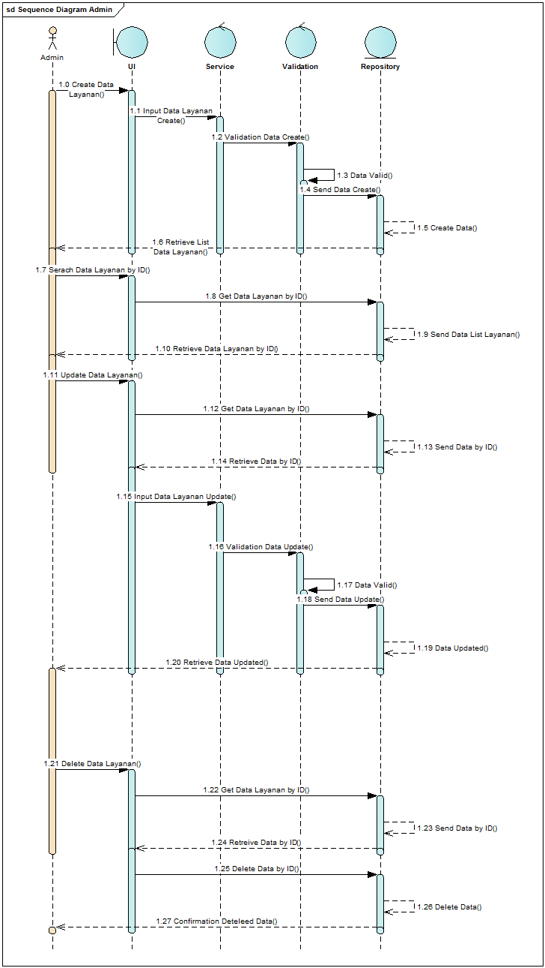
Sequence Diagram Admin

Slide 7
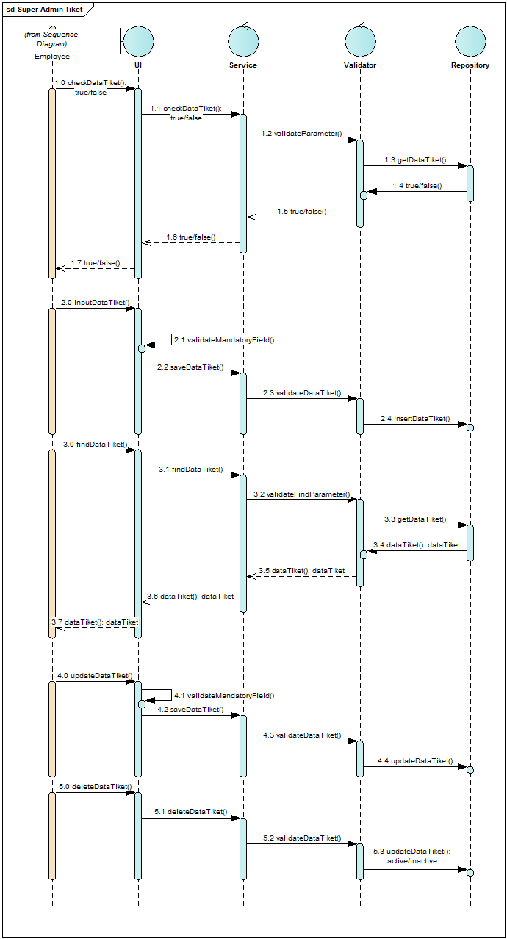
Sequence Diagram Employee

Slide 8
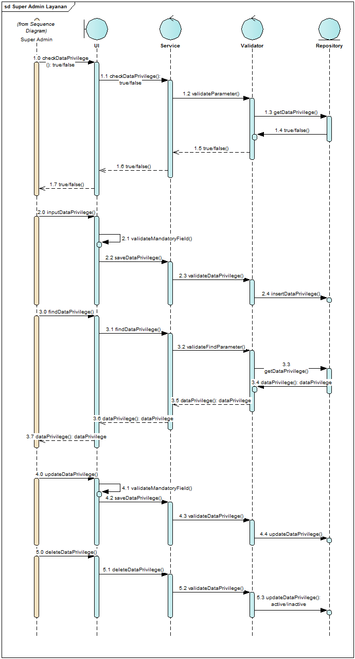
Sequence Diagram Super Admin (Privilege)

Slide 9
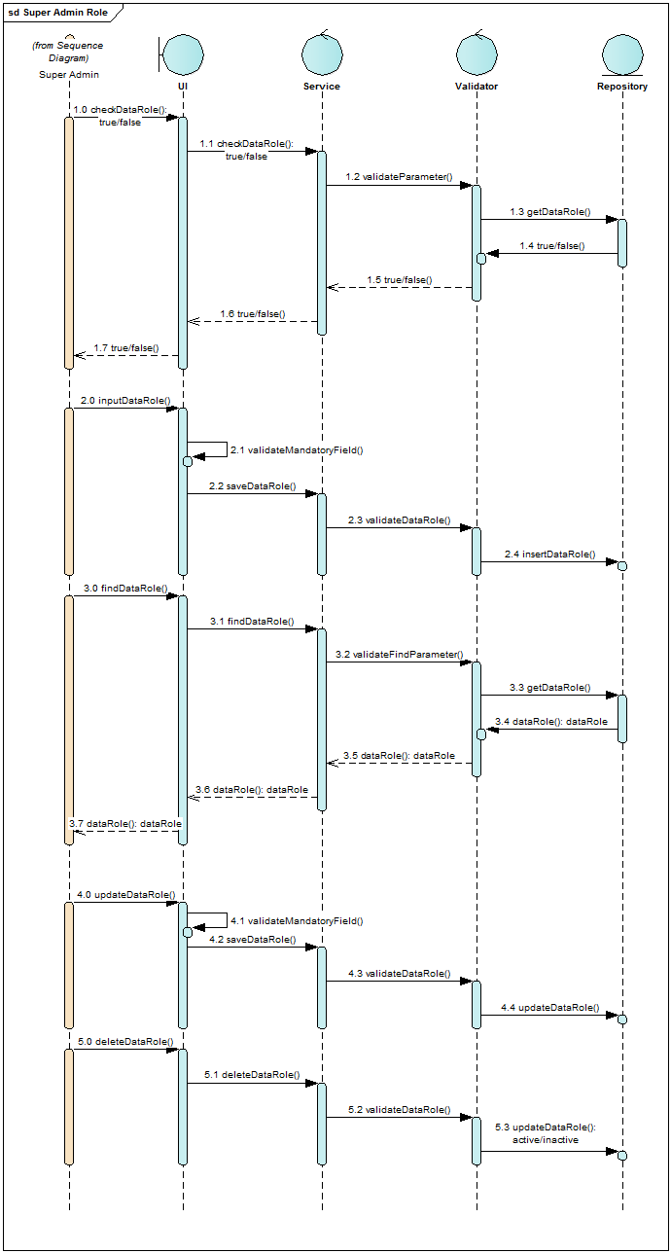
Sequence Diagram Super Admin (Role)

Slide 10
Sequence Diagram Super Admin (User)

Slide 11

Sequence Diagram Super Admin (Layanan)

Slide 12

Sequence Diagram Super Admin (Tiket)

Slide 13
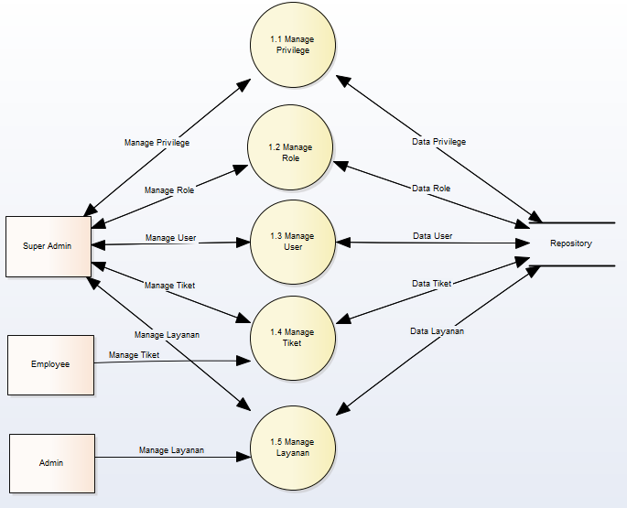
Data Flow Diagram Level 0

Slide 14
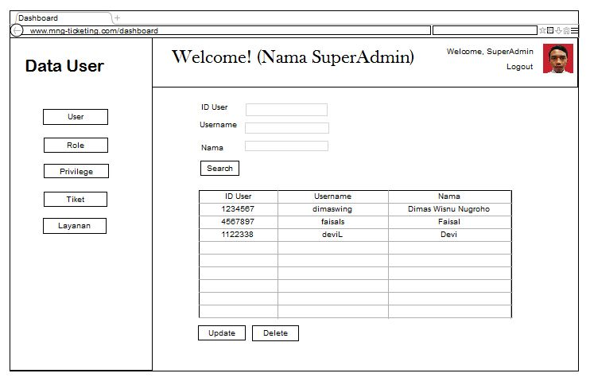
User Interface (Form Beranda)

Slide 15
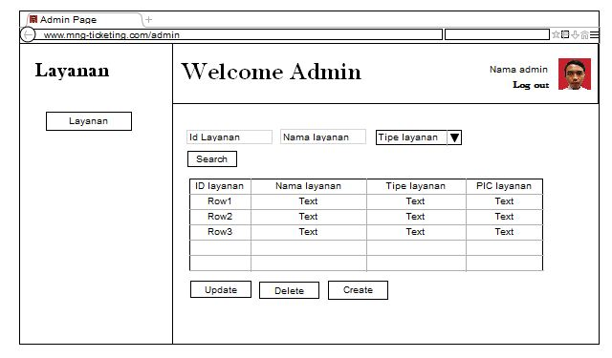
User Interface (Layanan)

Slide 16
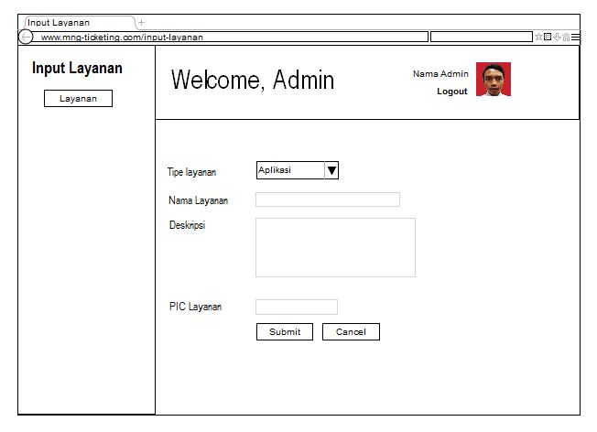
User Interface (Form Create Layanan)

Slide 17
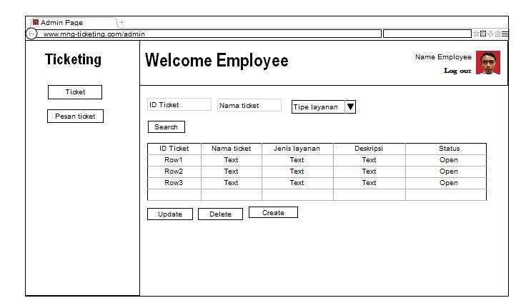
User Interface (Ticketing)

Slide 18
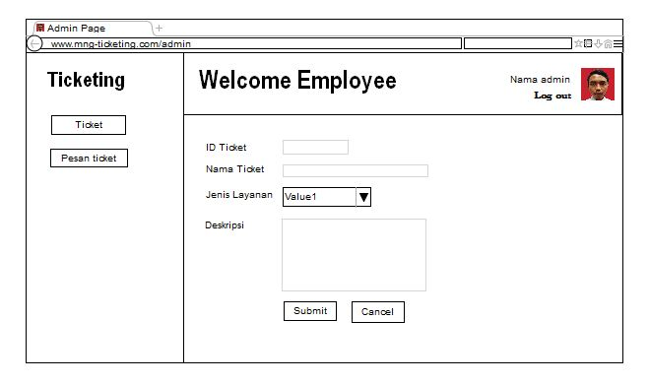
User Interface (Form Create Tiket)

Slide 19
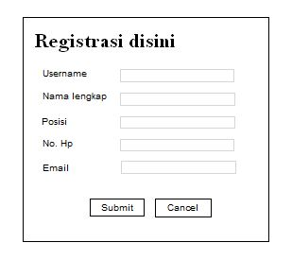
User Interface (Form Pendaftaran)

Slide 20
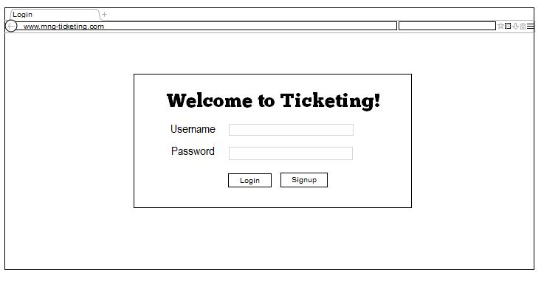
User Interface (Login)

Slide 21

Image source : https://6a3b790c7cfc9220ebe5-eb61d9770b9e4a1d2dacebe5287fbc1d.ssl.cf2.rackcdn.com/7qq3NqF2CL_1400654247096.jpg

